Slide 1
Hurricane Katrina Update: PD&R Assistance
Dana Bres, P.E.
Research Engineer
Affordable Housing Research and Technology Division
Office of Research, Evaluation and Monitoring
Notes:
Impact of Hurricane Katrina and some of the actions PD&R took in the aftermath

Slide 2
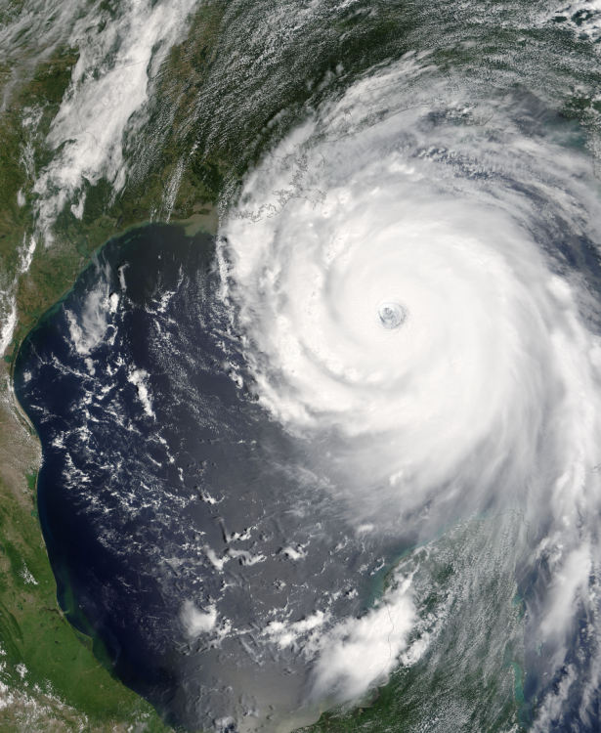
Hurricane Katrina
Landfall on 29 August 2005
Florida to Texas
Impact mainly to Louisiana and Mississippi
Flooding in New Orleans
Storm surge in coastal Mississippi
Damage to homes, businesses and communities
Notes:
With the 5th anniversary, we have seen the television footage

Slide 3
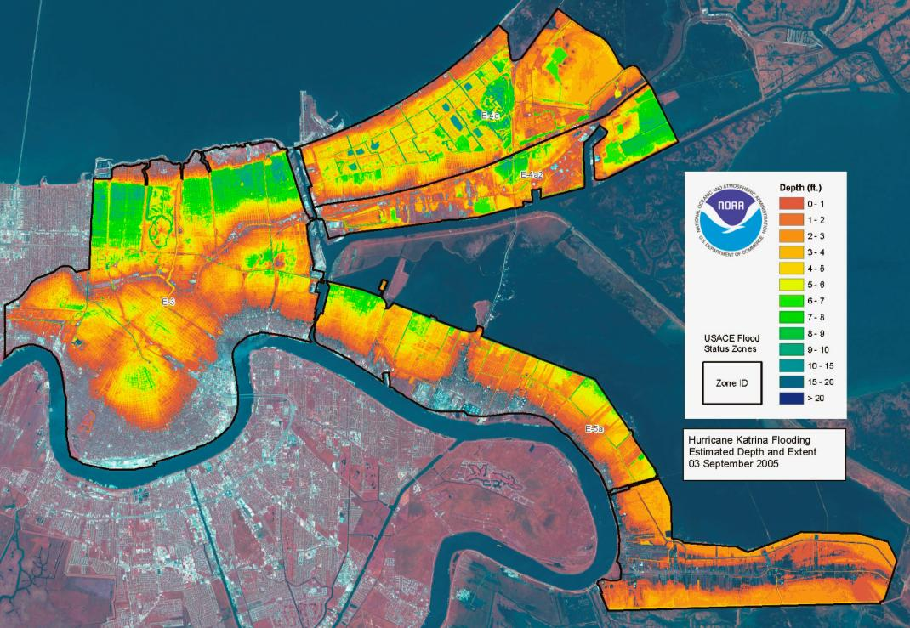
Flooding Extensive in New Orleans
Lakeview
Gentilly
Lower 9th Ward
French Quarter
Notes:
This map shows the extent of flooding in New Orleans
The green color indicates the deepest flood depths, from 6 to 10 feet
Point out Lower 9th, Lakeview and Gentilly
Point out the French Quarter and Superdome

Slide 4
Katrina’s Impact on Gulf States
Storm surge damage in coastal areas
Extensive damage in coastal Mississippi
Flooding in New Orleans from levee failure
Damage comparable to next four largest major disasters from past 20 years (Hurricanes Andrew and Ike, Midwest floods and Northridge earthquake)
Private and public property damage
HUD supplemental CDBG funding $19.7 billion
1.3 million homes damaged, 300,000 with major/severe damage
Notes:
To help understand the impact of Hurricane Katrina, it may help to provide some context.
The National Climate Data Center estimates the damage from Katrina to be about $134 billion in 2007 dollars, approximately the same as the total of the next four largest disasters, the Northridge Earthquake in 1994, Hurricane Andrew in 1992, Midwest Floods of 1993, and Hurricane Ike in 2008.
The 1.3 million damaged homes is about 1 percent of the total housing stock

Slide 5
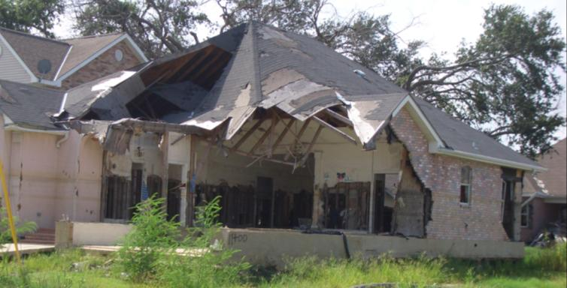
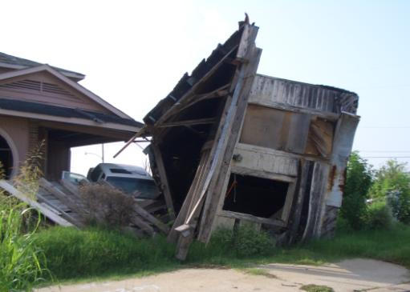
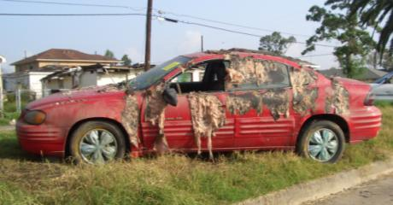
Impacts and Challenges
Housing losses
Community and Housing demographics
High homeownership
Modest income
Existing systems overwhelmed
Flooding lengthened response and increased damage
Resident’s desire to stay
Notes:
The impacts of Katrina were magnified by a number of social issues including :
Older housing stock
High homeownership without mortgage, which might have resulted in less insurance coverage
Poverty
Delays in returning to the neighborhoods contributed to the damage and likely extended the individual impacts
Residents had strong roots in their communities and most wanted to return

Slide 6
PD&R Immediate Evaluation and Involvement
Model for allocation of CDBG funding to affected states
Framework for New Orleans Recovery
Prototype for Long Term Community Recovery Planning
Mold Study for New Orleans
Economic Assessment activities
Analytical support for HUD leadership
Notes:
In the immediate aftermath of Katrina, PD&R provided analytical support to the department
In essence, we became HUD’s think tank for many response activities
This led to the PD&R effort to develop a framework for New Orleans recovery, which examined the physical, community and economic issues surrounding recovery. This was an early version of what has now become the Long Term Community Recovery Planning process

Slide 7
Federal Innovations and Activities
Disaster Housing Assistance Program
Alternative Housing Pilot Program
State leadership of housing efforts
Joint Housing Solutions Group
Identify alternatives to conventional disaster housing
Long Term Community Recovery
Rapid Rental Rehabilitation
Bringing housing on line regardless of source of damage
PD&R Disaster Research
Notes:
PD&R remains actively involved in a number of innovations shown here.

Slide 8
Disaster Housing Assistance Program - Katrina
Pilot program provided extended temporary housing assistance to nearly 37,000 hurricane-affected families
Enabled families to relocate out of the disaster area
Helped families prepare for greater housing self-sufficiency
Initial Lessons Learned
Many DHAP-Katrina families needed assistance for more than 4 years
Approximately 12,000 families transitioned to the HCV program
Case management services were valuable and necessary
PD&R study of a sample of 3,000 DHAP-Katrina families is ongoing
Notes:
The Disaster Housing Assistance Program builds on the framework of the Housing Choice Voucher model, providing housing assistance to families new to the program
Dr. Marina Myhre from PD&R is currently studying the efficacy of DHAP, which we will be able to use to refine and improve the program
Initially, we have seen the need for long-term housing assistance and the need for case management to help these families recover

Slide 9
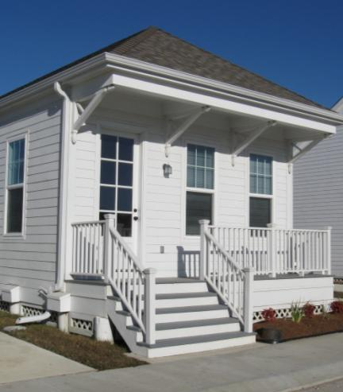
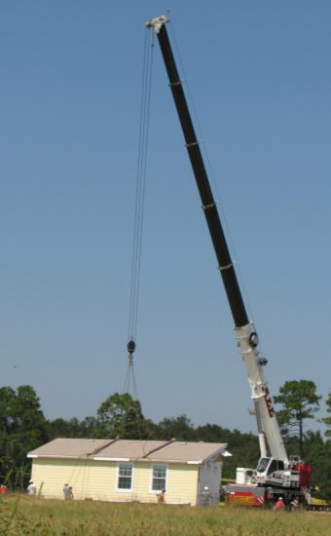
Alternative Housing Pilot Program
FEMA pilot to examine housing alternatives
One-time, $400 million
Grants to Alabama, Mississippi, Louisiana and Texas
About 4,000 homes produced
PD&R involvement
Program guidance
Evaluating proposals
Program evaluation
Lessons
- Long-term temporary housing
Strong local support critical
Notes:
AHPP is a one-time FEMA program where PD&R was asked to conduct an evaluation.
We helped FEMA with every step of the process, from crafting the initial grant notice to assisting the grantees in execution.
The program produced housing in four states, using different models proposed by those states.
We have learned that the quality of the housing matters to the disaster survivor and that should speed recovery
In execution, we have seen that strong local support is

Slide 10
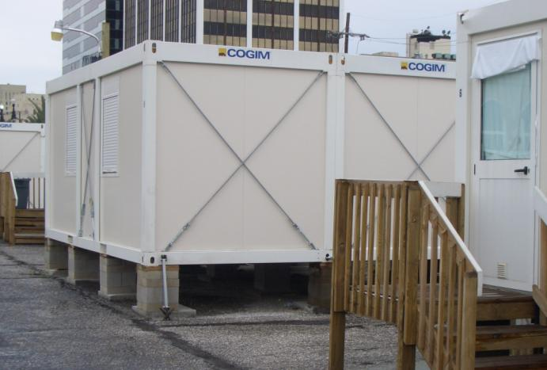
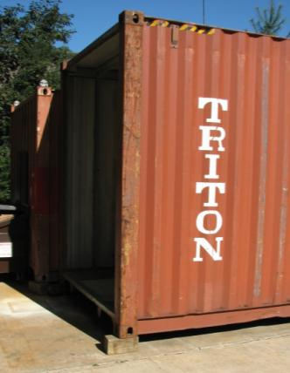
Joint Housing Solutions Group
FEMA effort
HUD partnership
Identify and assess alternatives to traditional disaster housing
What is new?
Issues include
Production capacity
Utility for long-term use
Construction standards
Design expectations

Slide 11
Rapid Rental Rehabilitation
Authorized under the Post-Katrina Emergency Management Reform Act
Temporary authorization for evaluation
FEMA allowed to repair available housing undamaged by disaster event
Tested in Cedar Rapids, IA and Galveston, TX
Significant interest
Non-profit housing providers often have units
Modest per unit cost
No authority for future use

Slide 12
PD&R Disaster Housing Research
Roadmap for Disaster Housing Research
Enhancing Disaster Resistance
Disaster Resistance in Existing Homes
Incremental Reconstruction of Damaged Homes
Benefits of Specific Disaster Housing Strategies
Establishing Housing Production Factories Outside Disaster Areas
Accessible Disaster Housing Designs
Performance Requirements for Disaster Housing

